Slide 1
Revolutionary War Test
By: Autumn Wooten

Slide 2
What does the vocabulary word Loyalists mean?
A= someone who stays loyal to England
B= someone who likes to play
C= someone who owes money to the government

Slide 3
Sorry

Slide 4
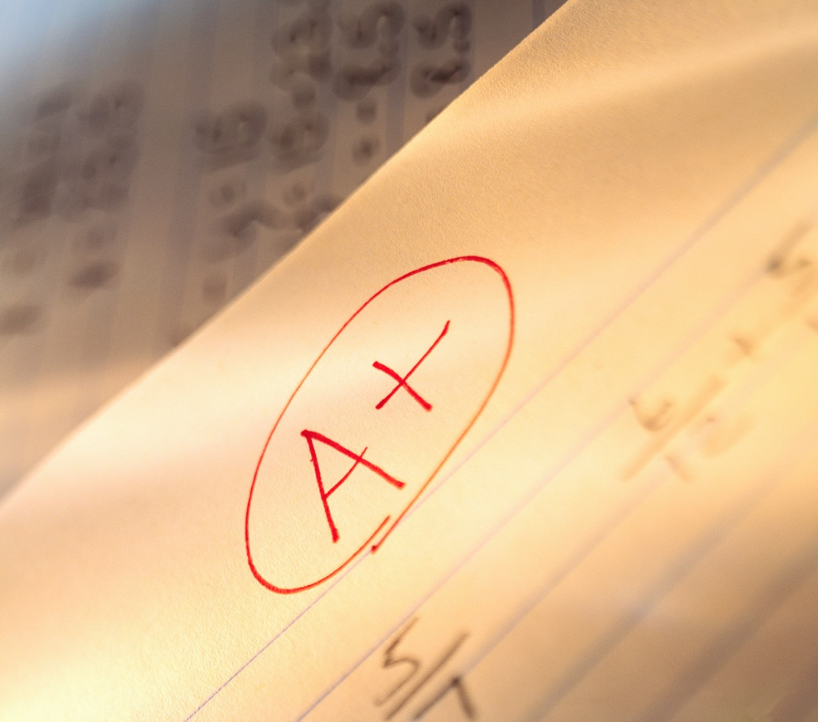
Correct!
Click here for
next slide

Slide 5
Who was sent for Dr. Joseph Warren in Boston?
A= George Washington
B=Paul Revere
C= John Adams

Slide 6
Sorry

Slide 7
Correct!
Click here for
next slide

Slide 8
Thomas Paine wrote a Pamphlet called ??????
A=Common Sense
B=Declaration of Independence

Slide 9
Sorry

Slide 10
Correct!
Next Question

Slide 11
Who wrote the Declaration of Independence?
A=Thomas Jefferson
B=Benjamin Franklin
C=Thomas Paine

Slide 12
Sorry

Slide 13
Correct!
Click here for
next slide

Slide 14
What does the vocabulary word Independence mean?
A=To be a teacher
B=To be independent; self confident
C=To believe in freedom

Slide 15
Sorry

Slide 16
Correct!
Click here for
next slide

Slide 17
Who was the person who led the troops?
A=Thomas Paine
B=John Adams
C=George Washington

Slide 18
Sorry

Slide 19
Correct!
Click here for
next slide

Slide 20
What does Patriot mean?
A=An American colonists that supported the fight against England.
B=Someone who helped the soldiers fight in the war.
C=A student who graduated high school.

Slide 21
Sorry

Slide 22
Correct!
Click here for
next slide

Slide 23
How long did it take Thomas Jefferson to write the Declaration of Independence?
A=1 month
B=17 days
C=1 year

Slide 24
Sorry

Slide 25
Correct!
Click here for
next slide

Slide 26
On July 9, George Washington read the Declaration of ???? To his ?????
A=Proclamation, Patriot
B=Loyalists, Minutemen
C=Independence, Troops

Slide 27
Sorry

Slide 28
Correct!
Click here for
next slide

Slide 29
Finish this sentence “No Taxation without ???”
A=Representation
B=Independence
C=Congress

Slide 30
Sorry

Slide 31
Correct!
Click here for
next slide

Slide 32
When was Fort Ticonderoga captured?
A=July 4,1776
B=May 10,1775
C=December 25,1767

Slide 33
Sorry

Slide 34
Correct!
Click here for
next slide

Slide 35
Who was one of the people shot at the Boston Massacre?
A=Thomas Jefferson
B=George Washington
C=Crispus Attucks

Slide 36
Sorry

Slide 37
Correct!
Click here for
next slide

Slide 38
What was the Act where colonists dressed up as Indians and threw tea over the ship?
A=Boston Massacre
B=Boston Tea Party
C=Townshend Act

Slide 39
Sorry

Slide 40
Correct!
Click here for
next slide

Slide 41
When was the Declaration of Independence made?
A=July 4, 1776
B=July 2, 1776
C=July 9, 1776

Slide 42
Sorry

Slide 43
Correct!
Click here for
next slide

Slide 44
When was the Declaration of Independence fully read and edited?
A=July 9, 1776
B= July 4, 1766
C=July 4, 1776

Slide 45
Sorry

Slide 46
Correct!
Click here for
next slide

Slide 47
What does territory mean?
A=Land owned by the government
B=A building with customers
C=A state that helped Great Britain

Slide 48
Sorry

Slide 49
Correct!
Click here for
next slide

Slide 50
What is Article 5 about in the Constitution?
A=Explains how you may change the amendments
B=Creates the Executive Branch; The Presidency
C=Explains the rights and the powers of the states

Slide 51
Sorry

Slide 52
Correct!
Click here for
next slide

Slide 53
What does Article 3 state?
A=Creates the Legislative or law making branch
B=Creates the Judicial Branch; the Constitution
C=Says the constitution is the highest law in the land

Slide 54
Sorry

Slide 55
Correct!
Click here for
next slide

Slide 56
Who signed their name so big that King George the third could see it from England?
A=John Hancock
B=George Washington
C=Benjamin Franklin

Slide 57
Sorry

Slide 58
Correct!
Click here for
next slide

Slide 59
Since there was no President in the Nation who led the states?
A=Congress
B=King George III
C=George Washington

Slide 60
Sorry

Slide 61
Correct!
Click here for
next slide

Slide 62
Thank You for taking my Test!
Thank You! Thank You! Thank You! Thank You!
Thank You! Thank You! Thank You! Thank You!
Thank You! Thank You! Thank You! Thank You!
Thank You! Thank You! Thank You! Thank You! Thank You! Thank You! Thank You! Thank You!
Thank You! Thank You! Thank You! Thank You!
Thank You! Thank You! Thank You! Thank You!
Thank You! Thank You! Thank You! Thank You!

