Slide 1
PAUL REVERE
BY: Juan Hernandez

Slide 2
Paul Revere’s childhood
Paul Revere was born in Boston on January 1734.
His father was a silversmith.
When he was seven or eight he learned manners and to read, write, and basic math.
When he was twelve he and a group of six other boys would ring the bells at a church.

Slide 3
Paul Revere’s loss
When Paul was seventeen his father died.
Being the oldest he worked in his father’s shop.

Slide 4
Paul Revere’s adulthood
When he turned twenty one he went to war to fight the French.
They fought small battles and had no real victories.
More soldiers died of disease than fighting.
That same year the survivors including Paul were sent home.
He then went back to the work shop to help his home.

Slide 5
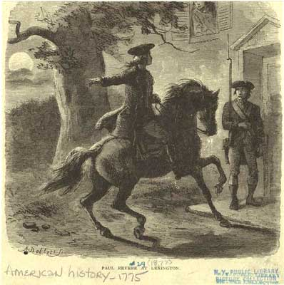
Why Paul Revere is a hero
On1775 the night before the battle of Lexington and Concord Paul went to concord to warn the people of the attack.
Because he did that he saved the lives of many people.
For that reason he is a hero.

Slide 6
Paul Revere’s death
On 1818 Paul died at a ripe age.
Before he died he was surrounded by his children and grand children and he told stories of his adventures to them.

